Slide 1
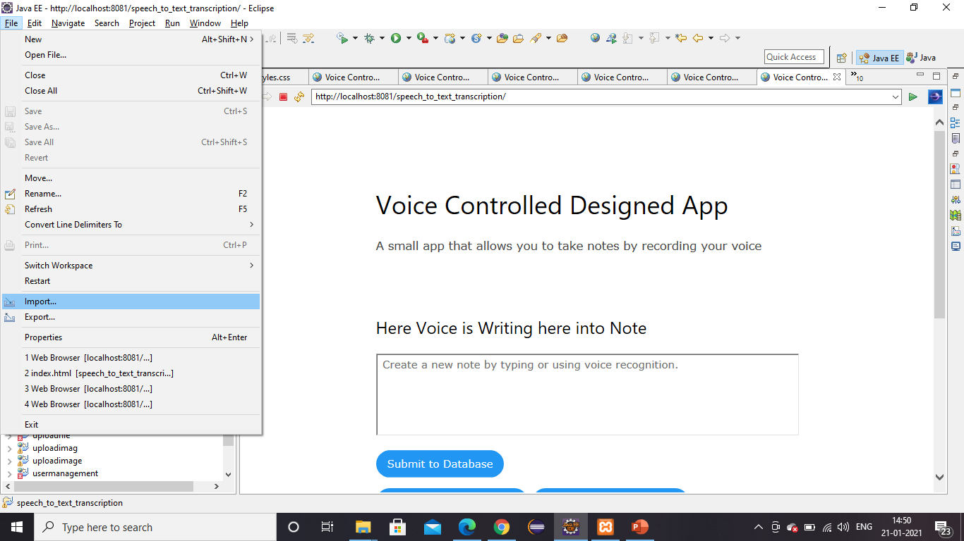
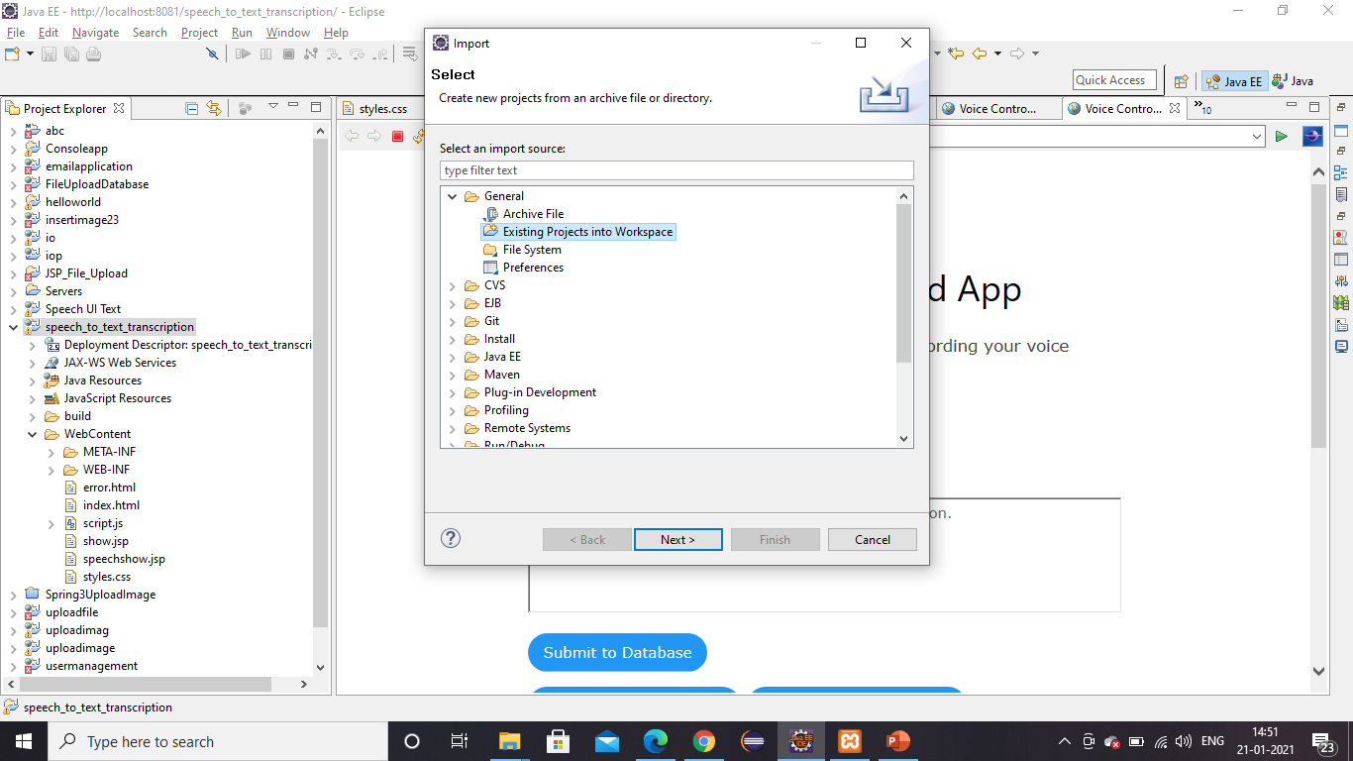
Speech to text Project
First open your Project into Eclipse Luna so please follow this step which is
Go to File=> import=>Existing Projects into Workspace

Slide 2
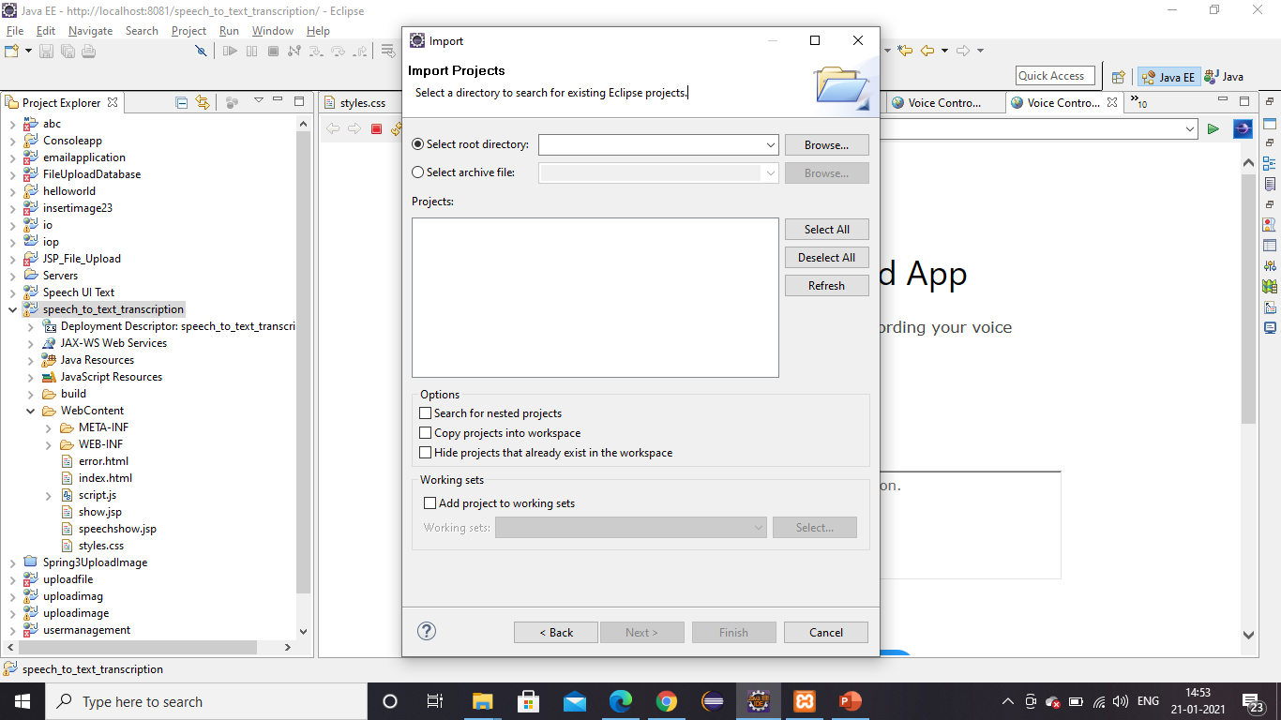
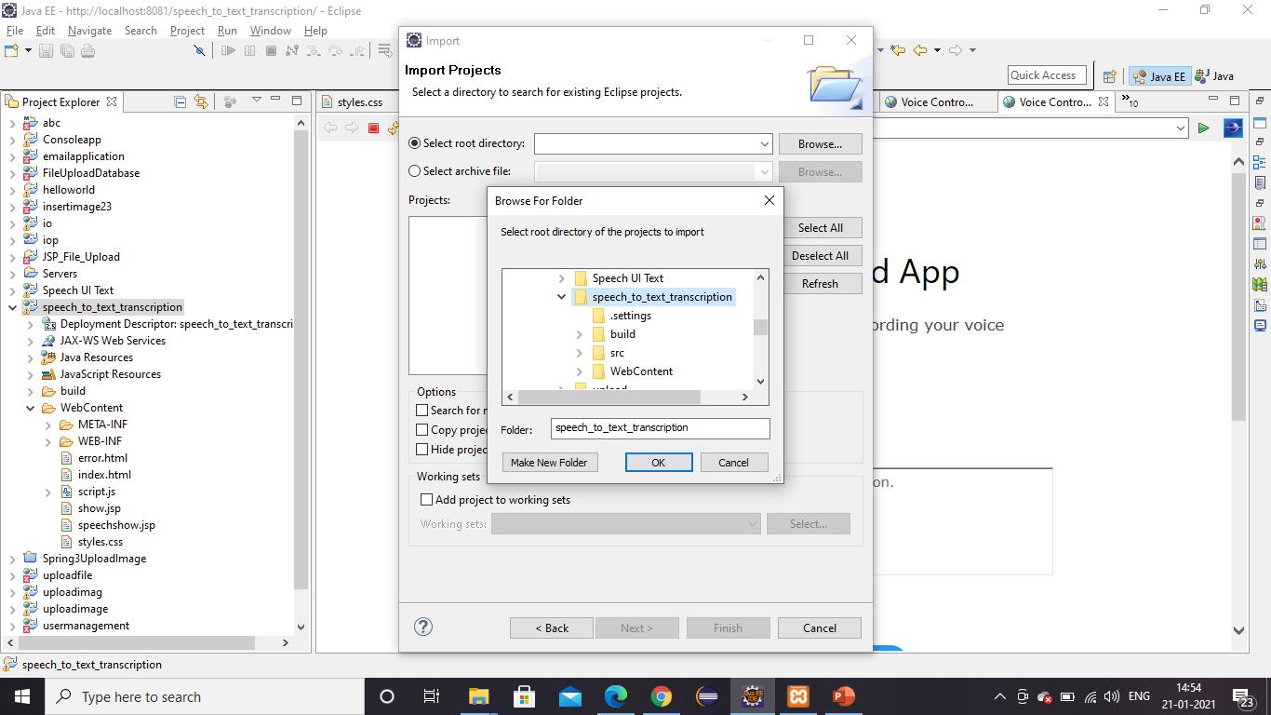
Speech to text Project
Here first go to Browser open your project from System then please click the Ok Button

Slide 3
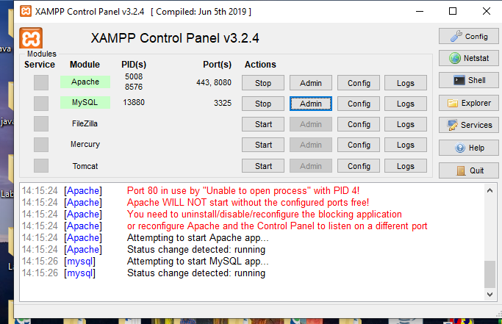
Speech to text Project
U have to install xampp server. Then click on xampp-control to open it. After that you have to open your MY sql database. & start the database.

Slide 4
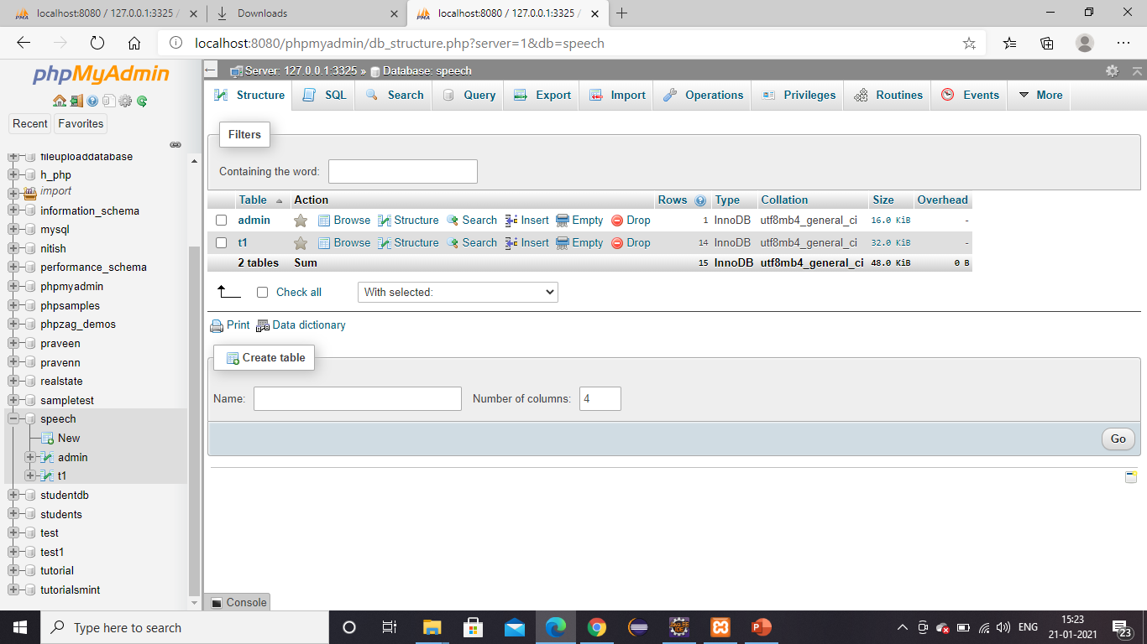
Speech to text Project
Click the admin button & My SQL data base will open as below.

Slide 5
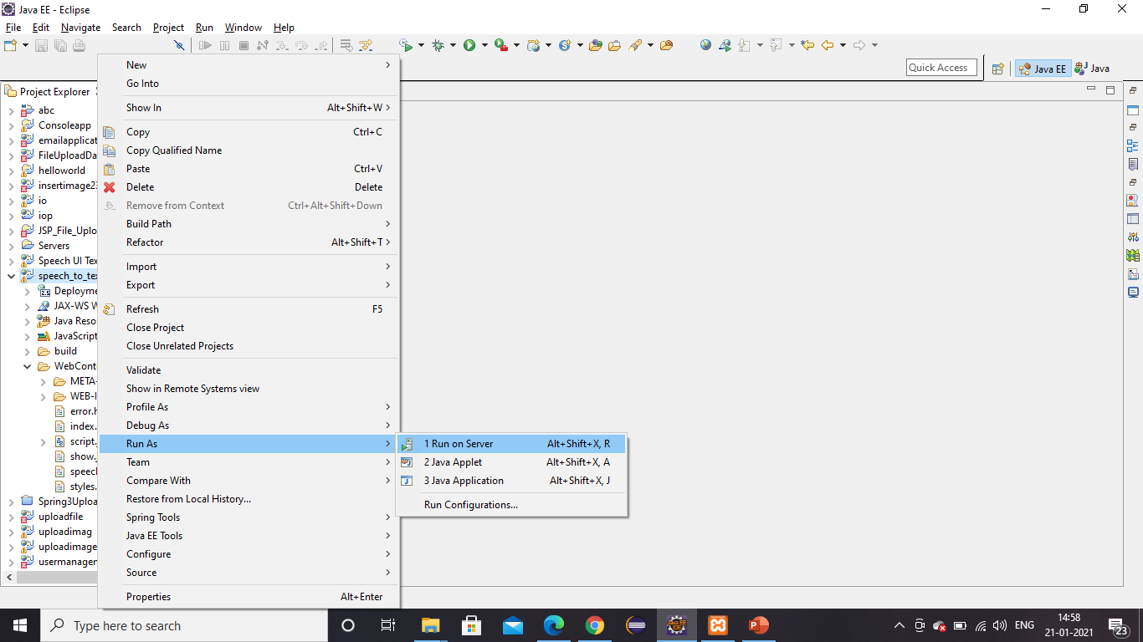
Speech to text Project
Run the Project as below.

Slide 6
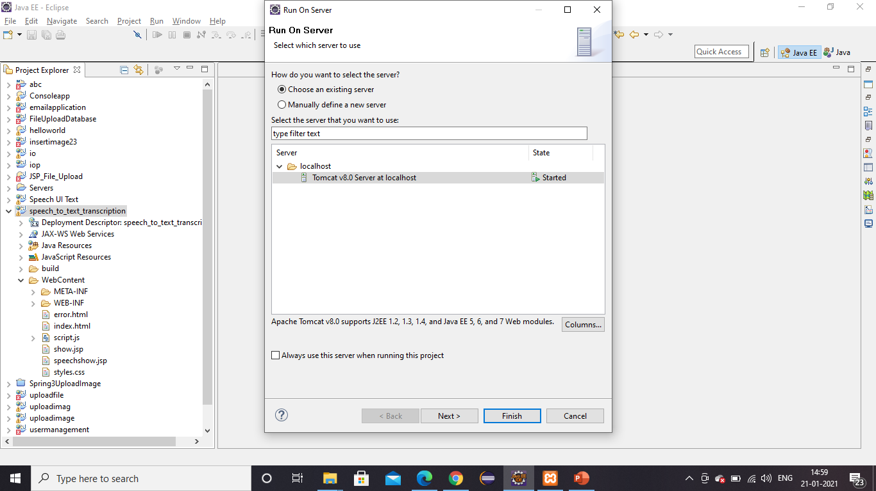
Speech to text Project
Click on Finish as shown below.

Slide 7
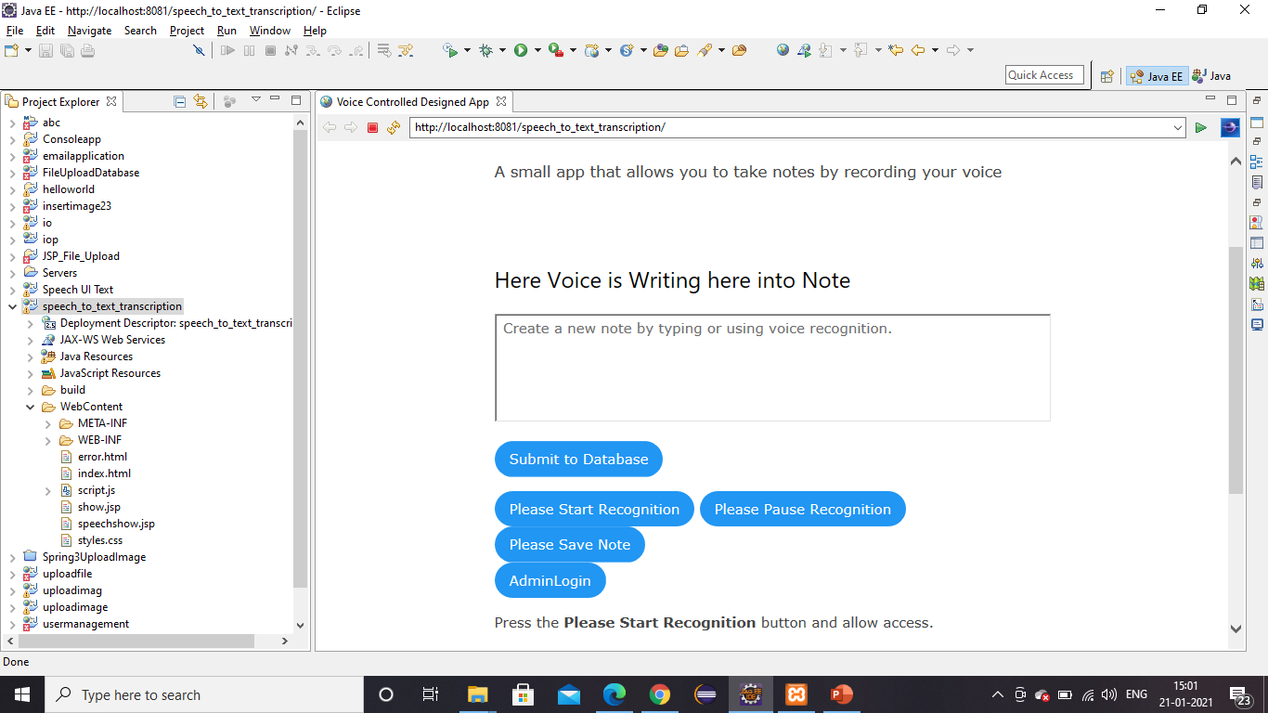
Speech to text Project
You will get below screen as shown below.
Copy the URL and paste it into google chrome browser

Slide 8
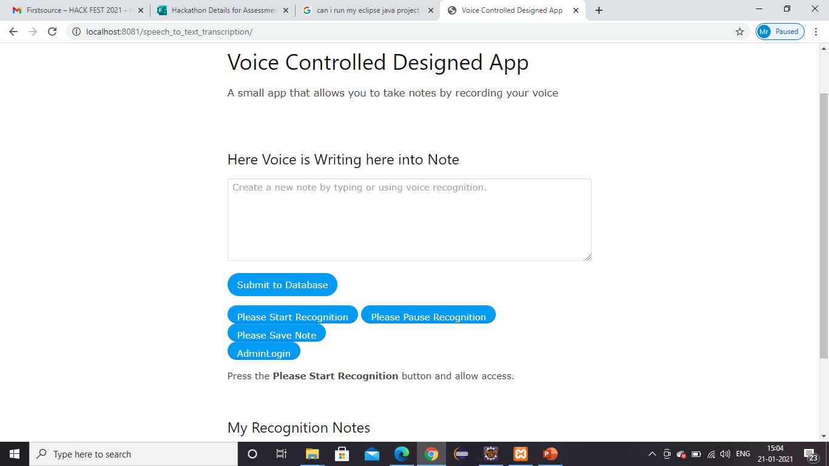
Speech to text Project
In google chrome it will look like below

Slide 9
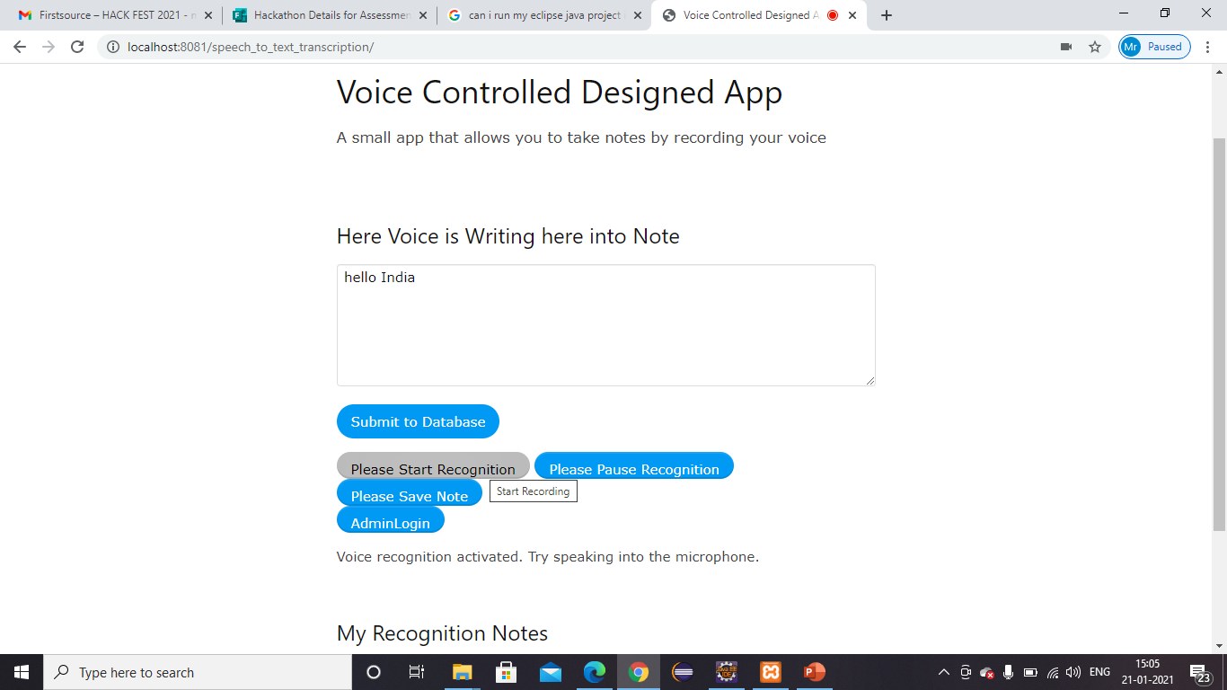
Speech to text Project
In google chrome it will look like below screenshot. Click on “Please start Recognition” button and start talking something and same will appear in the text box as a text.

Slide 10
Speech to text Project
If you click on “Submit to database” it will save into database.

Slide 11
Speech to text Project
There are some others buttons also. U can click and check those functionalities as well.

Slide 12
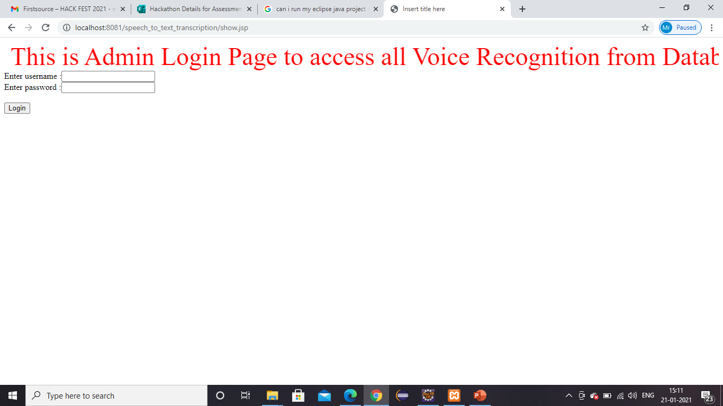
Speech to text Project
By clicking on “admin login” and by giving id & password u can see all speech texts which saved into database.
Admin ID : suman
Password : password

Slide 13
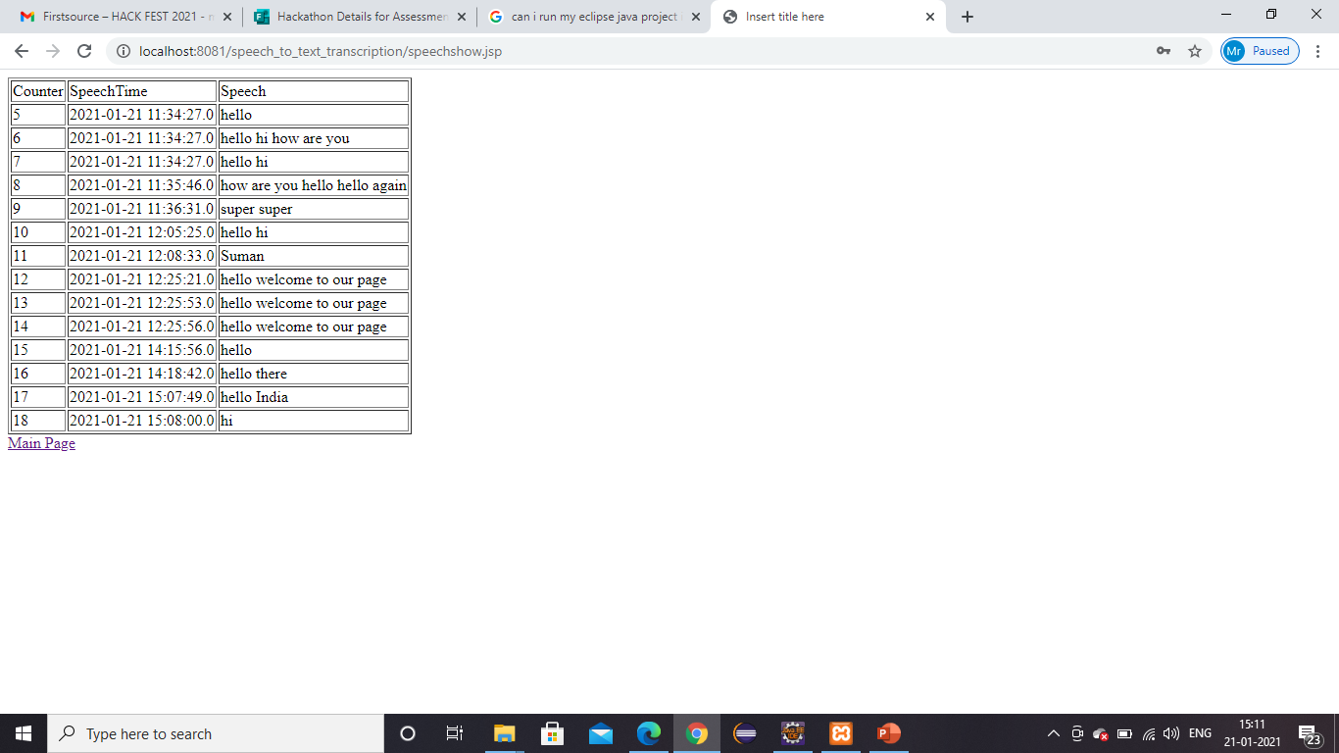
Speech to text Project
By clicking on “admin login” and by giving id & password u can see all speech texts which saved into database.

